Slide 1
Classes and Objects
Prof. Madonna Lamin
ITMBU, SoCSET

Slide 2
Topics
What is a class?
What is an object?
Difference between class and object
What is an object reference?
What is a constructor?
Concepts of constructor overloading
Concept of method overloading
What is recursion?
Passing and returning object from function
What is the purpose of new operator?
Explain this and the super keyword
What is the purpose of finalize method?
Concept of access control and modifiers
Concept of nested class and inner class and anonymous inner class

Slide 3
Java Class and Object
Java is an object-oriented programming language. The core concept of the object-oriented approach is to break complex problems into smaller objects.
An object is any entity that has a state and behavior. For example, a bicycle is an object. It has
States: idle, first gear, etc
Behaviors: braking, accelerating, etc.

Slide 4
What is Java class?
A class is a blueprint for the object. Before we create an object, we first need to define the class.
We can think of the class as a sketch (prototype) of a house. It contains all the details about the floors, doors, windows, etc. Based on these descriptions we build the house. House is the object.
Since many houses can be made from the same description, we can create many objects from a class.

Slide 5
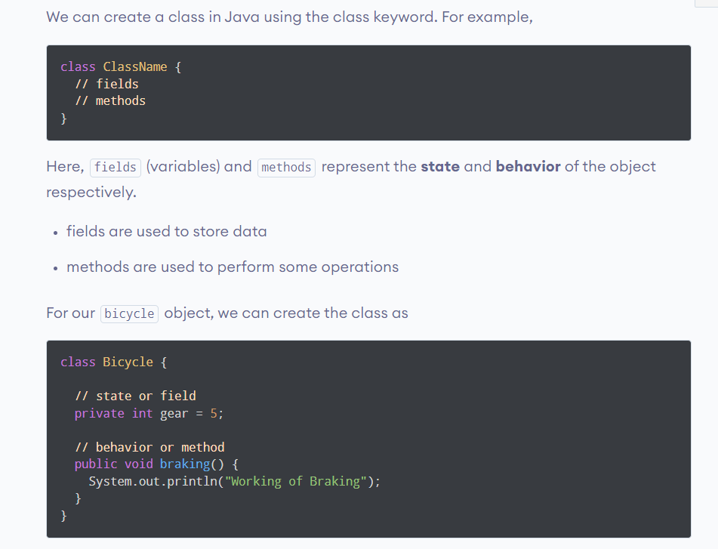
Create a class in Java

Slide 6
In the above example, we have created a class named Bicycle. It contains a field named gear and a method named braking().
Here, Bicycle is a prototype. Now, we can create any number of bicycles using the prototype. And, all the bicycles will share the fields and methods of the prototype.
Note: We have used keywords private and public. These are known as access modifiers.

Slide 7
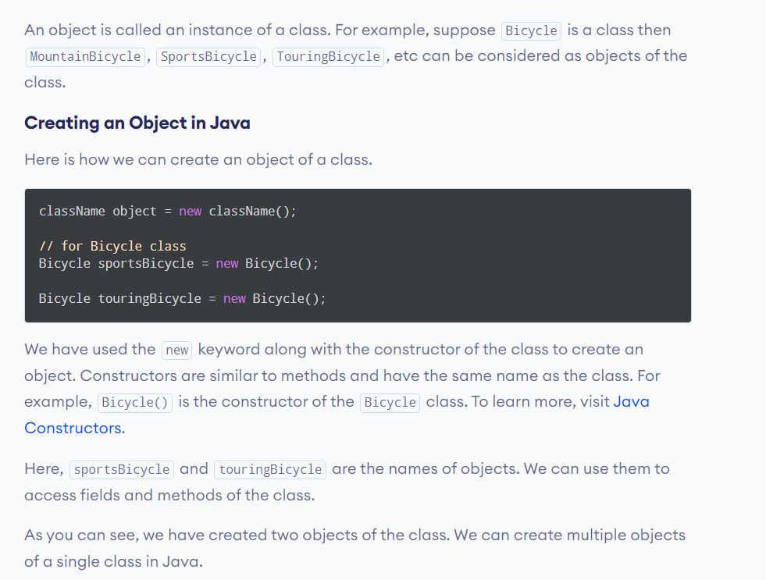
What are Java objects?

Slide 8
Note: Fields and methods of a class are also called members of the class.

Slide 9
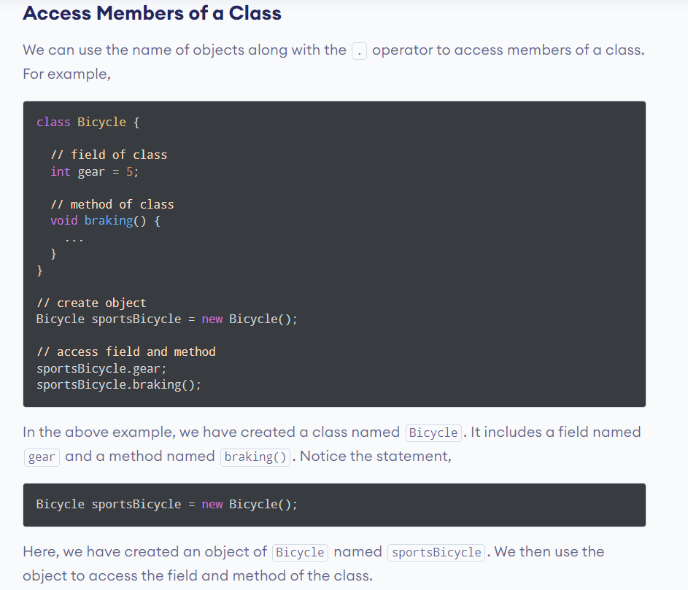

Slide 10
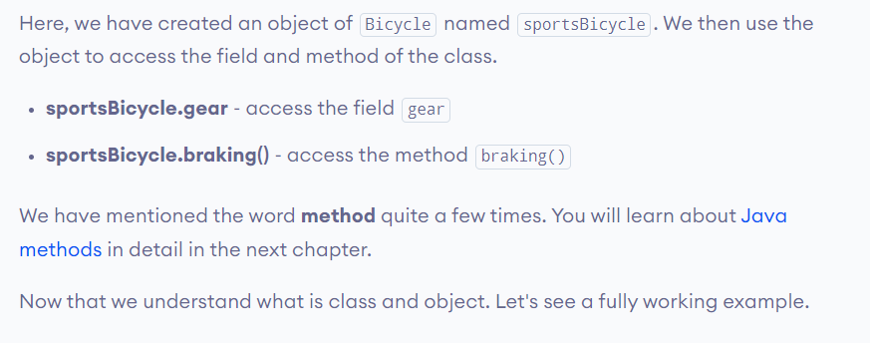

Slide 11
class Lamp {
// stores the value for light
// true if light is on
// false if light is off
boolean isOn;
// method to turn on the light
void turnOn() {
isOn = true;
System.out.println("Light on? " + isOn);
}
// method to turnoff the light
void turnOff() {
isOn = false;
System.out.println("Light on? " + isOn);
}
}

Slide 12
class Main {
public static void main(String[] args) {
// create objects led and halogen
Lamp led = new Lamp();
Lamp halogen = new Lamp();
// turn on the light by
// calling method turnOn()
led.turnOn();
// turn off the light by
// calling method turnOff()
halogen.turnOff();
}
}

Slide 13
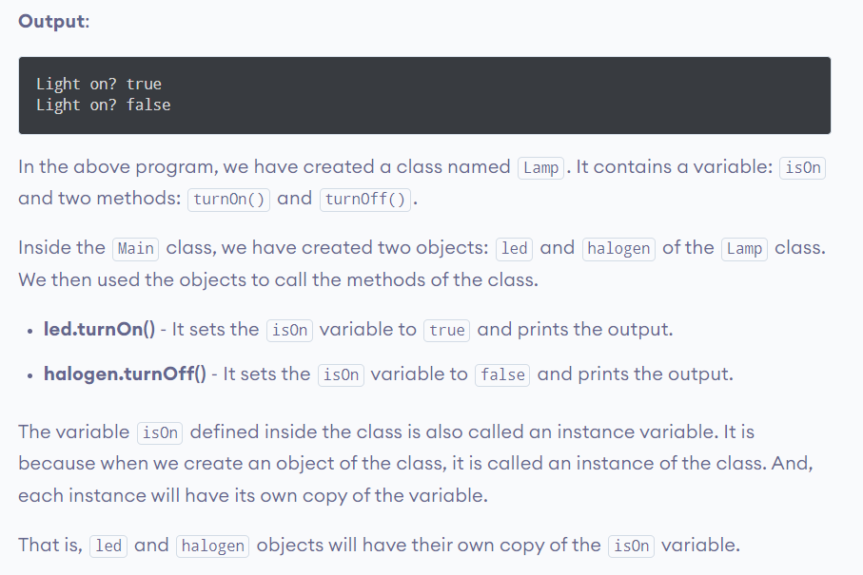

Slide 14
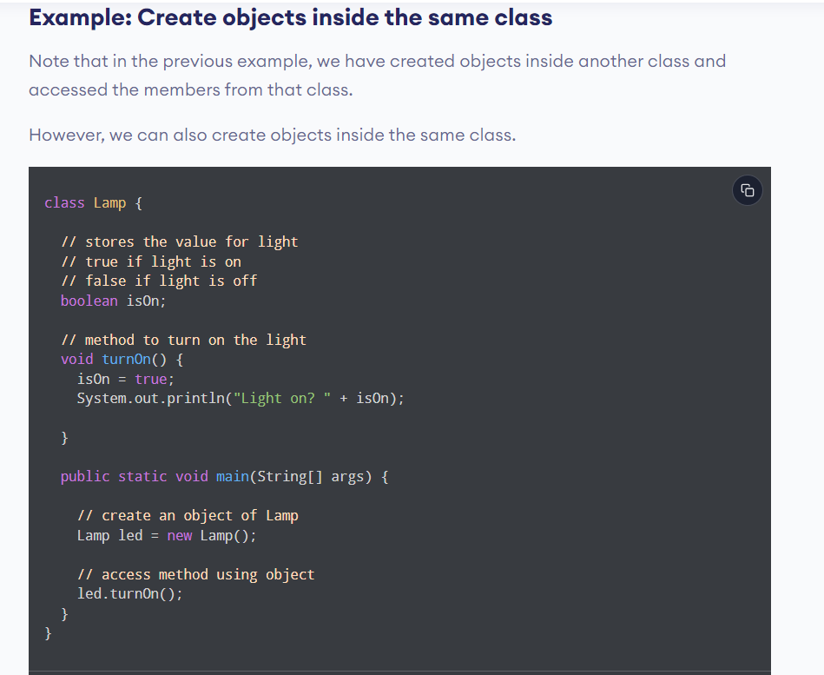

Slide 15
Differences between classes and objects
Object | Class
Object is an instance of a class | Class is a blueprint from which an object is created
Object is a real-world entity like car, chair, table, laptop etc | Class a group of similar objects
Object is a physical entity | Class is a logical entity
Object is created many times as per requirement | Class is created only once
Object is allocated memory when it is created | Class is not allocated memory when it is created
Object is created through the new keyword | Class is declared using the class keyword
There are different ways to create object using new keyword, newinstance() method, clone() method and deserialization | There is only one way to define a class that is by using the class keyword

Slide 16
What is an object reference?
null reference and NullPointerException error
Use object as an object variable and a method parameter
Create method that returns an object

Slide 17

Facts
When we create an object(instance) of the class then space is reserved in heap memory
Now, the space in the heap Memory is created but the question is how to access that space?.

Slide 18
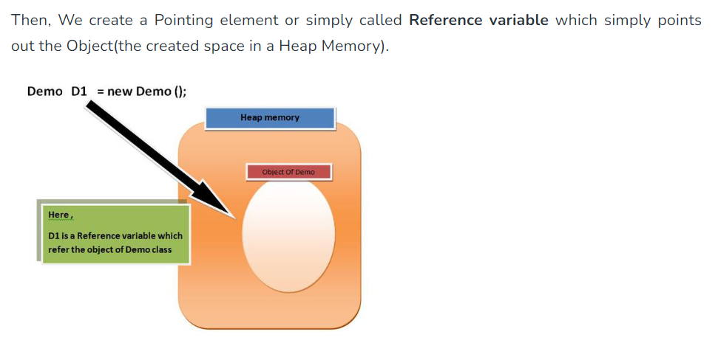

Slide 19
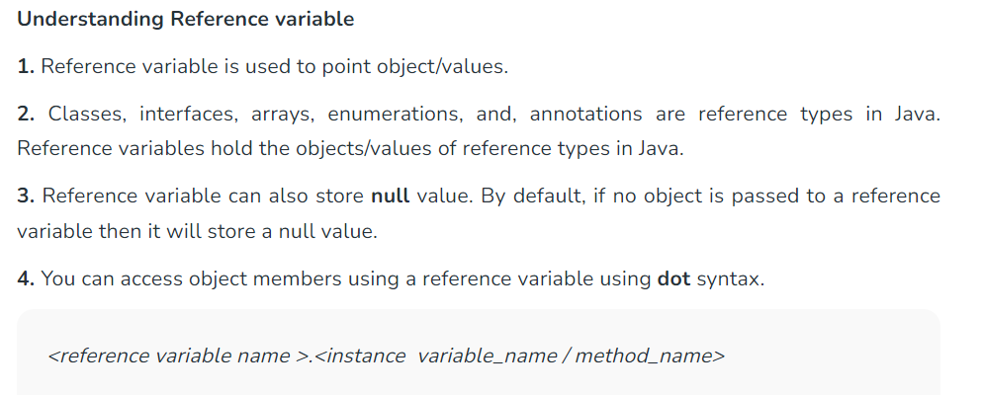

Slide 20
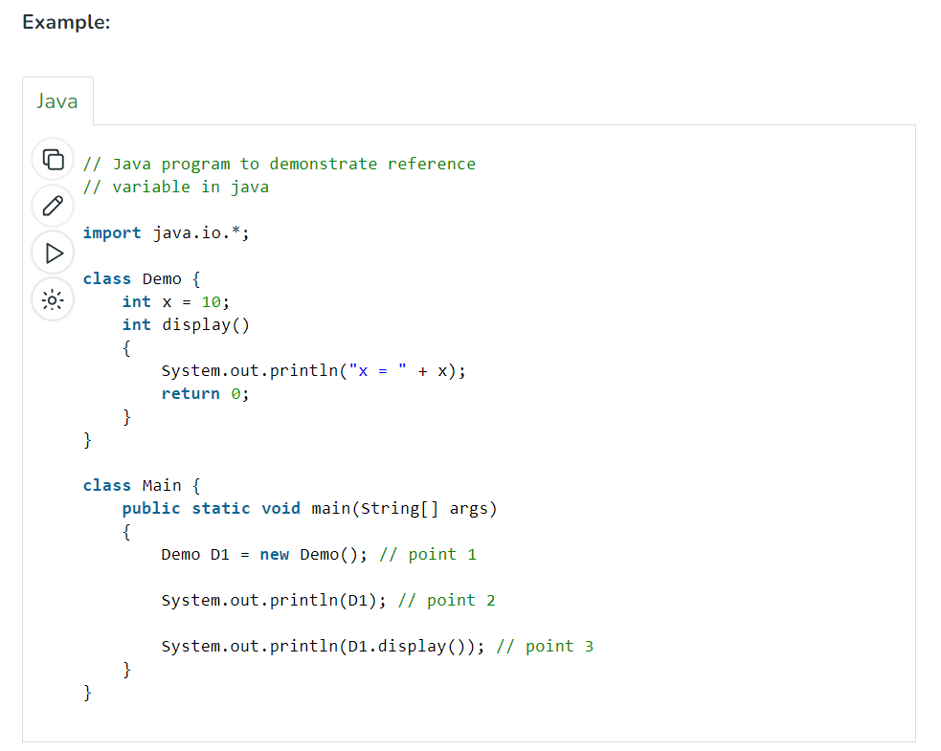

Slide 21
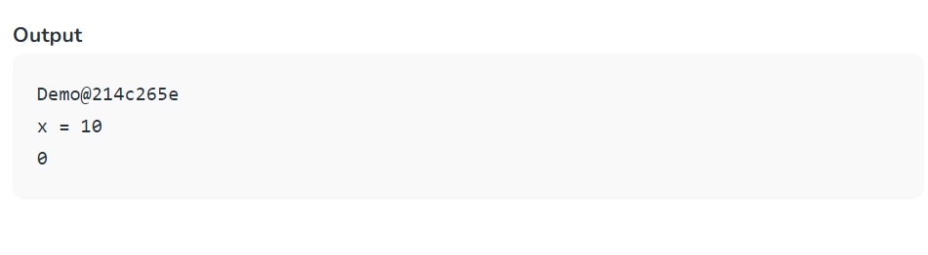

Slide 22
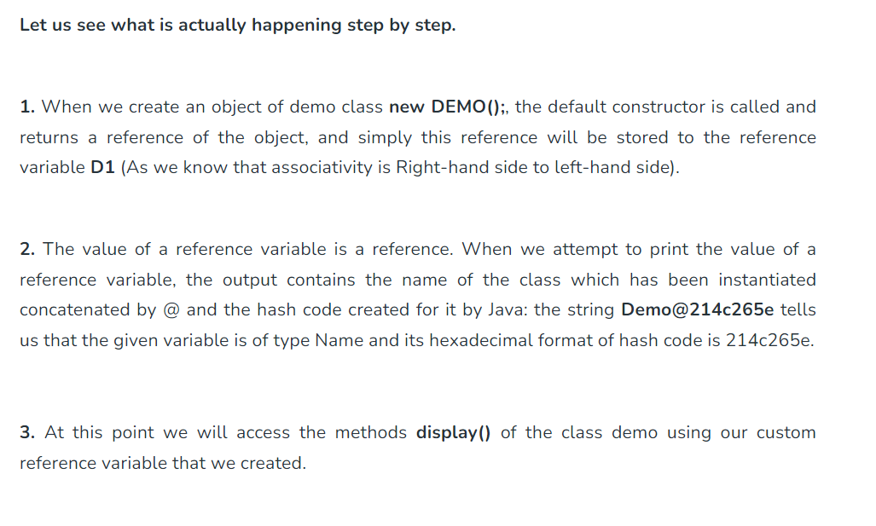

Slide 23
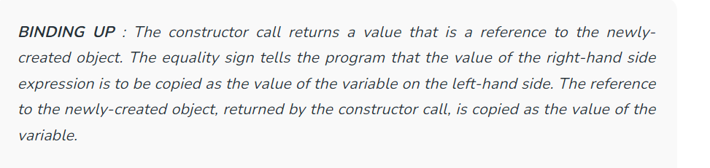

Slide 24
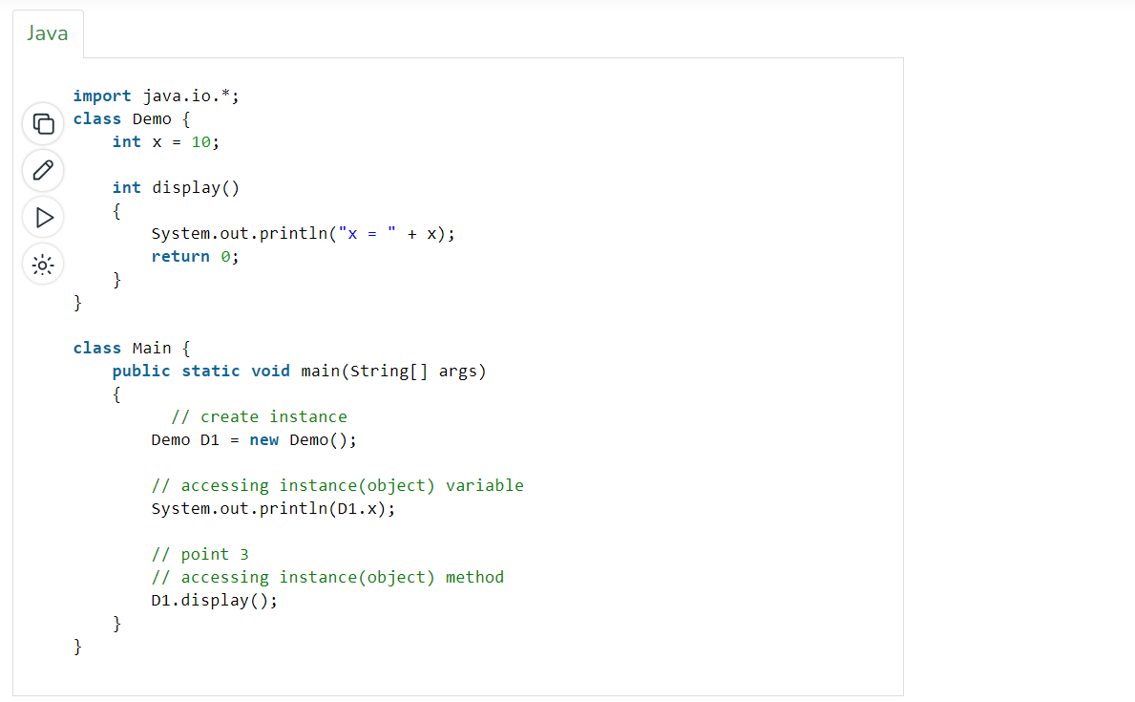

Slide 25
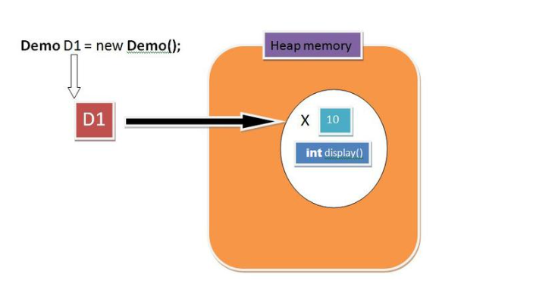

Slide 26
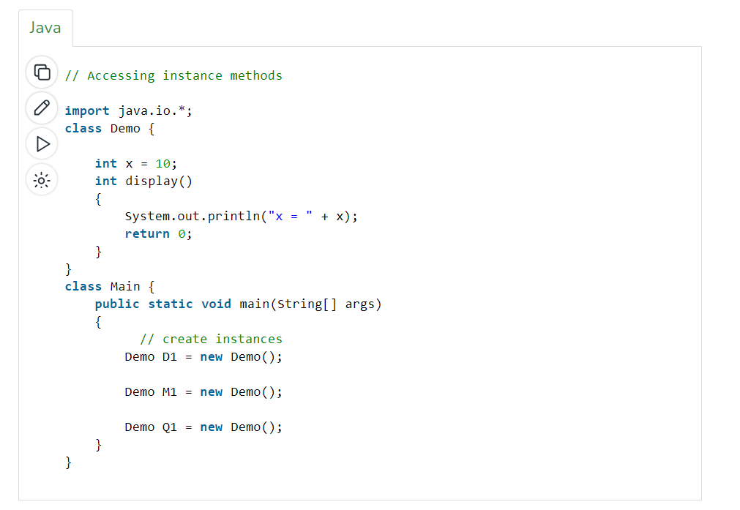

Slide 27
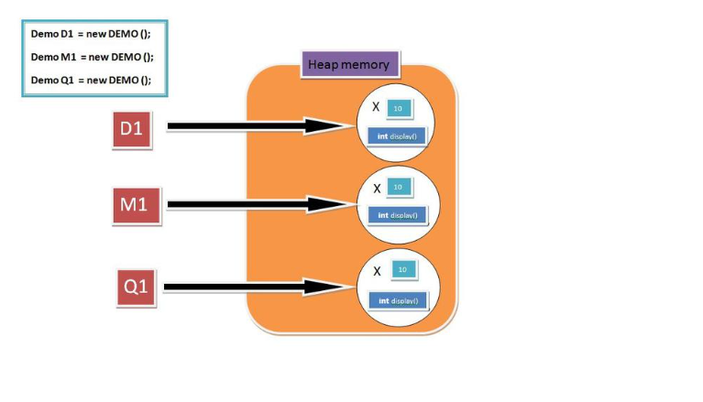

Slide 28
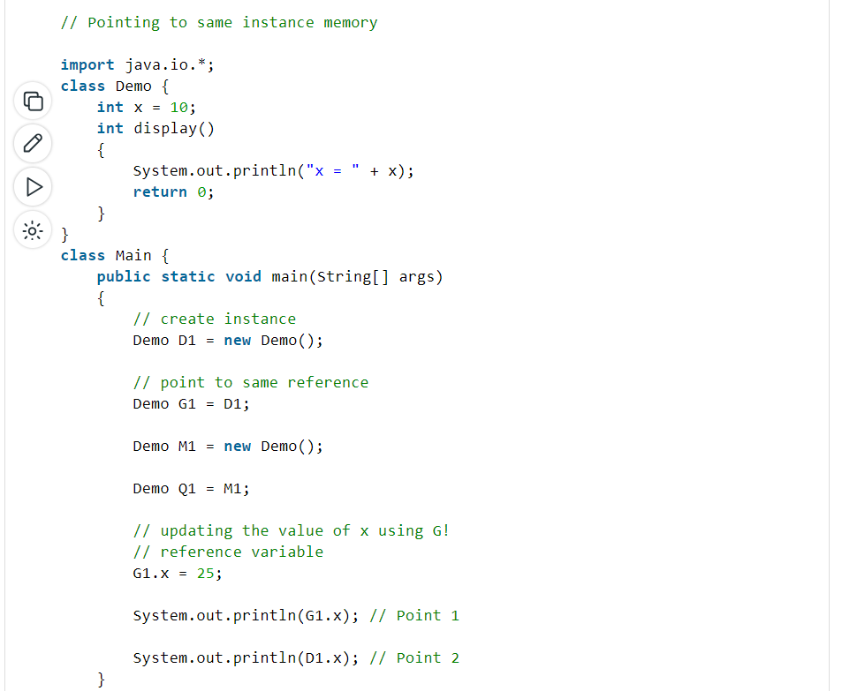

Slide 29
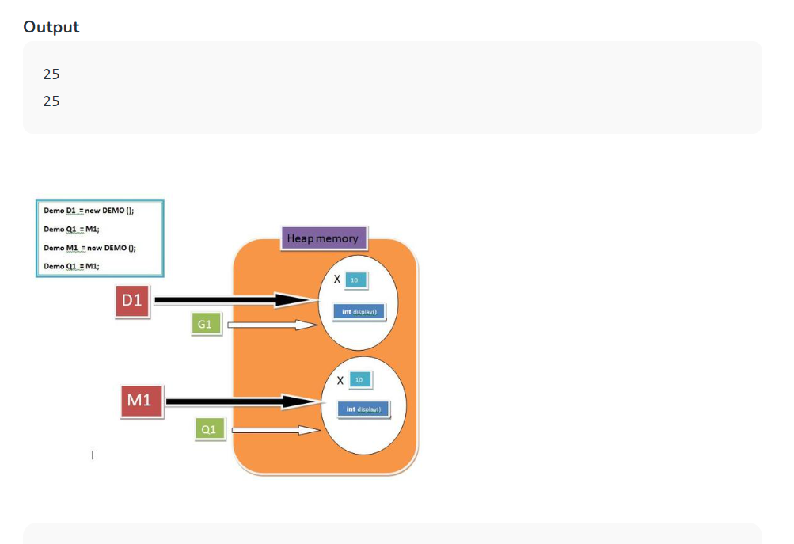

Slide 30
More on reference variable
Reference variable as method parameters
As the value of a primitive variable is directly stored in the variable, whereas the value of a reference variable holds a reference to an object. We also mentioned that assigning a value with the equality sign copies the value (possibly of some variable) on the right-hand side and stores it as the value of the left-hand-side variable. A similar kind of copying occurs during a method call. Regardless of whether the variable is primitive or reference type, a copy of the value is passed to the method’s argument and copied to that argument.

Slide 31
Note: Java only supports pass by value.
But we know that the reference variable holds the reference of an instance(OBJECT) so a copy of the reference is passed to the method’s argument.

Slide 32
// Pass by reference and value
import java.io.*;
class Demo {
int x = 10;
int y = 20;
int display(Demo A, Demo B)
{
// Updating value using argument
A.x = 95;
System.out.println("x = " + x);
System.out.println("y = " + y);
return 0;
}
}

Slide 33
class Main {
public static void main(String[] args)
{
Demo C = new Demo();
Demo D = new Demo();
// updating value using primary reference
// variable
D.y = 55;
C.display(C, D); // POINT 1
D.display(C, D); // POINT 2
}
}

Slide 34
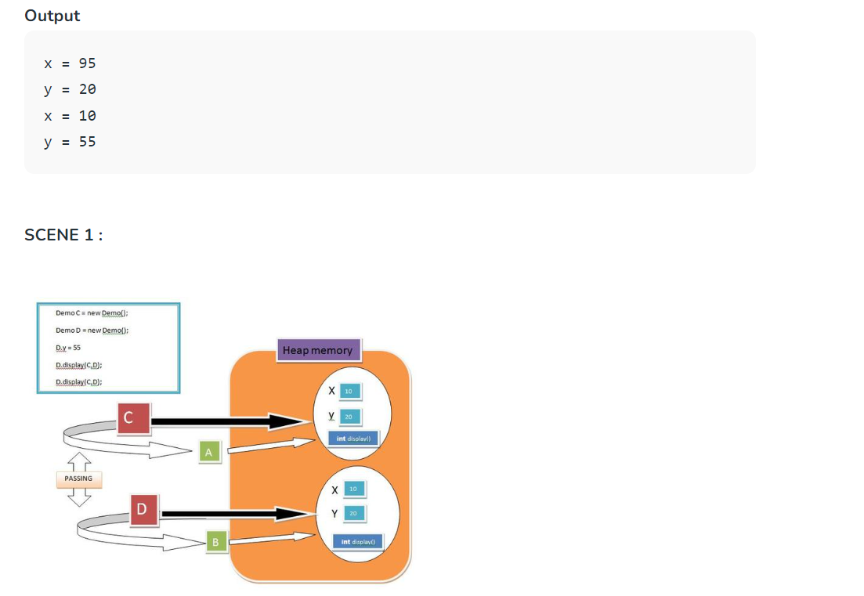

Slide 35
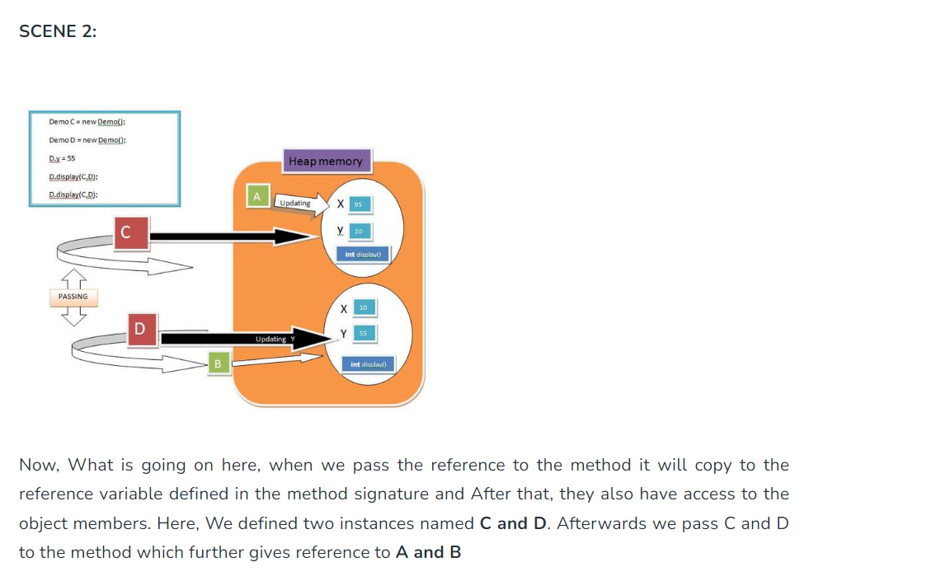

Slide 36
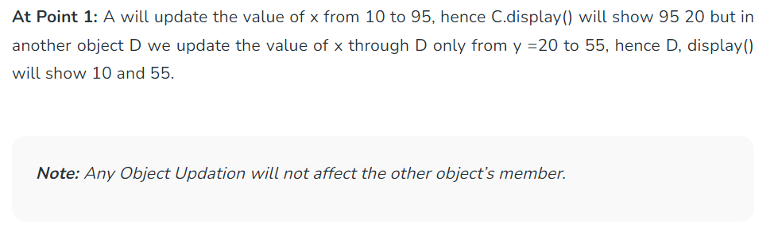

Slide 37
2. What if we swap the reference variables with the help of the Swap Method?
The fact is if we try to swap the reference variable, then they just swap their Pointing element there is no effect on the address of reference variable and object(Instance) Space. Let’s Understand It with the help of an example:

Slide 38
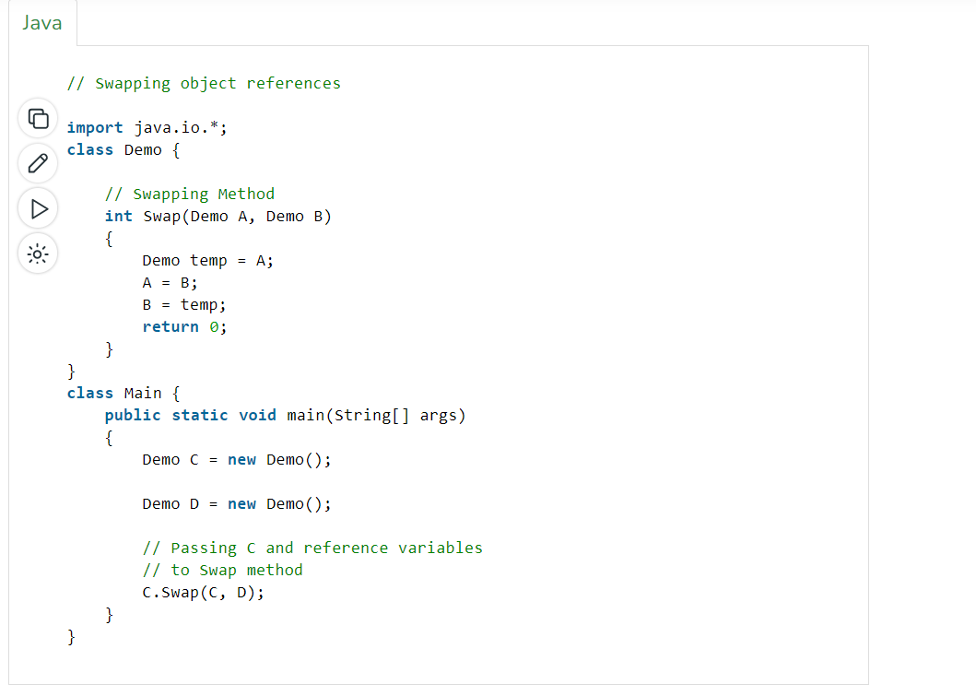

Slide 39
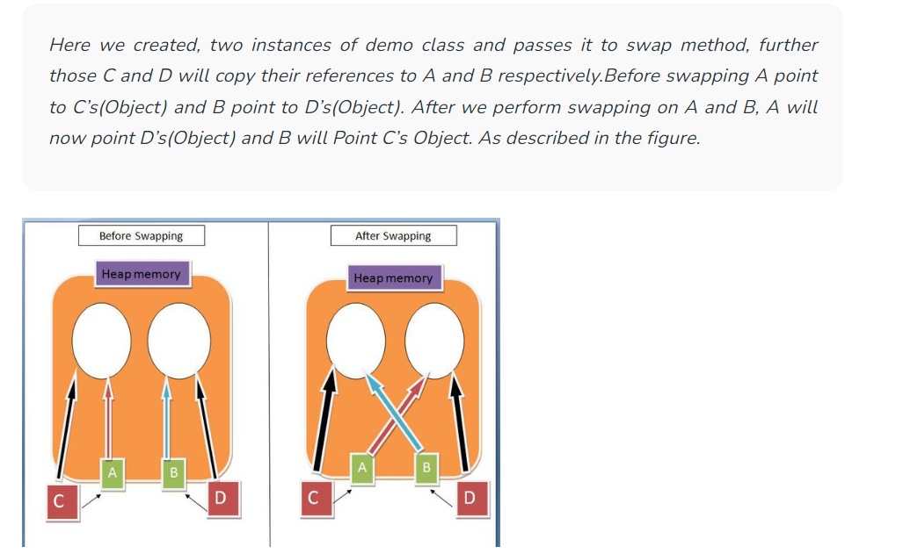

Slide 40
Note: There is no swapping between Variables, They only change their References.

Slide 41
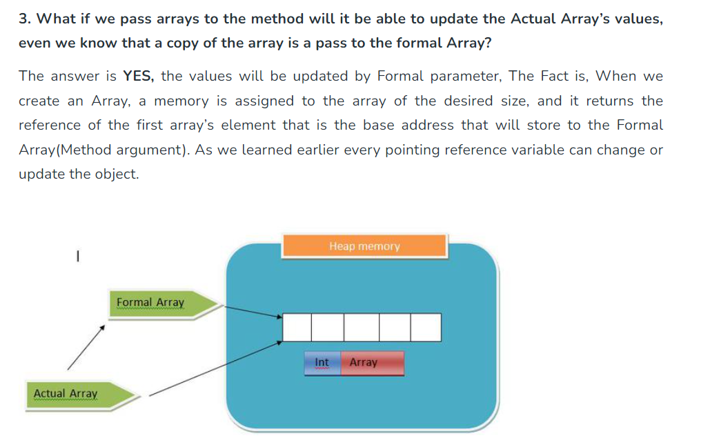

Slide 42
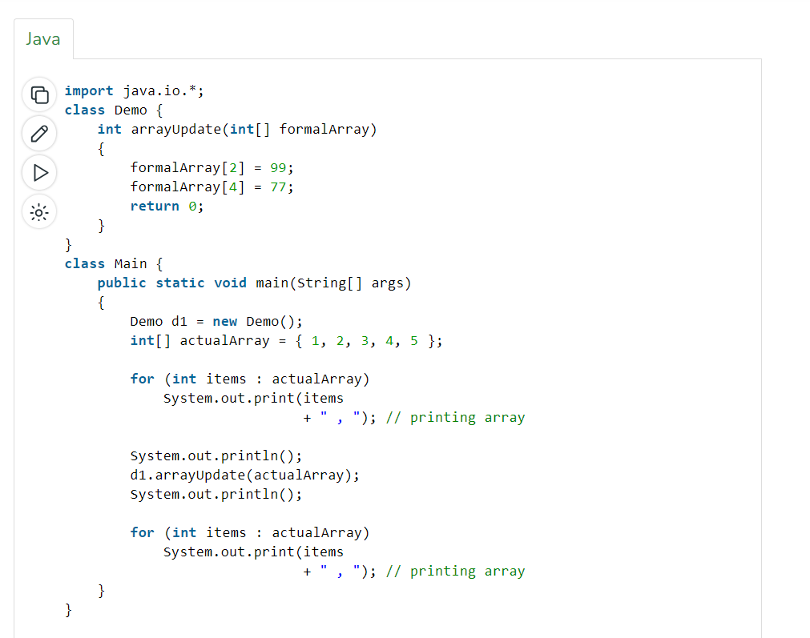

Slide 43


Slide 44
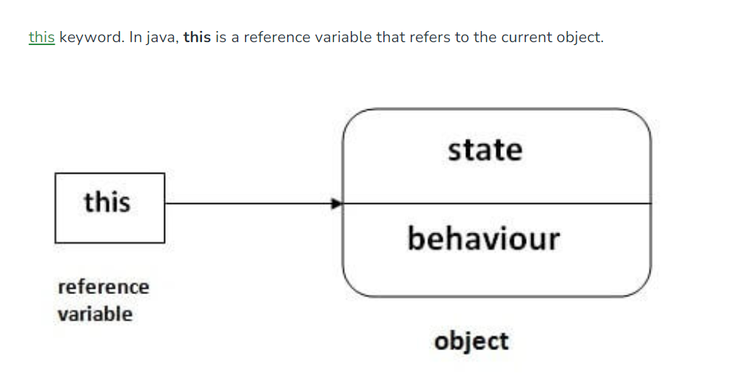
4. this and super keywords are also Pointing Elements.

Slide 45
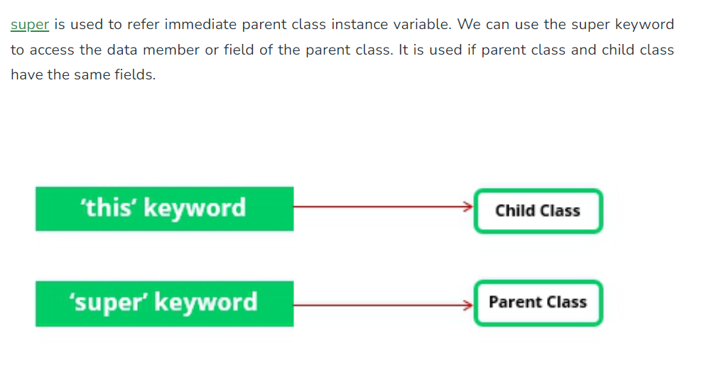

Slide 46
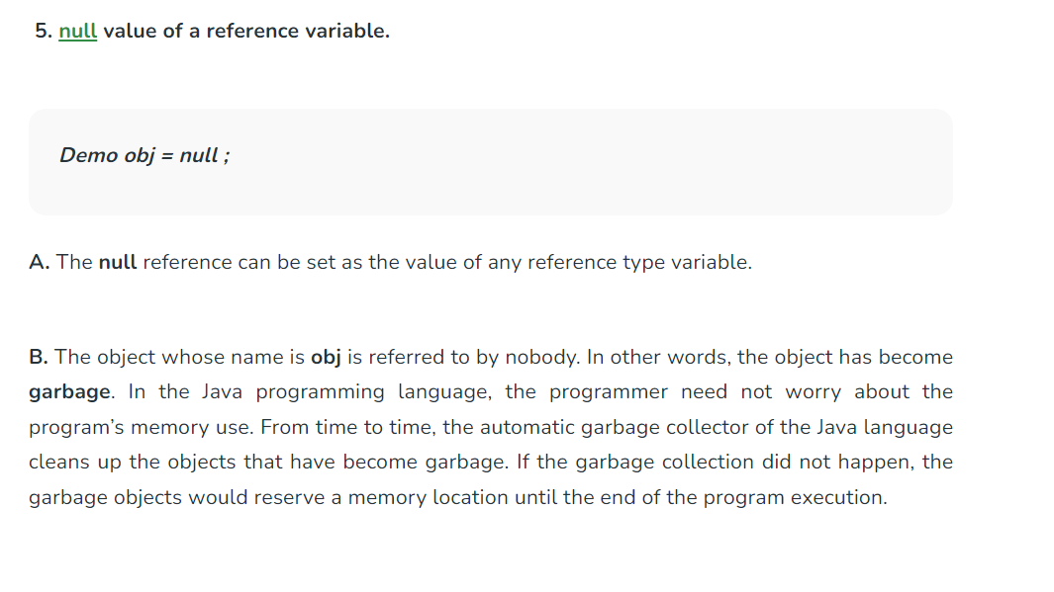

Slide 47
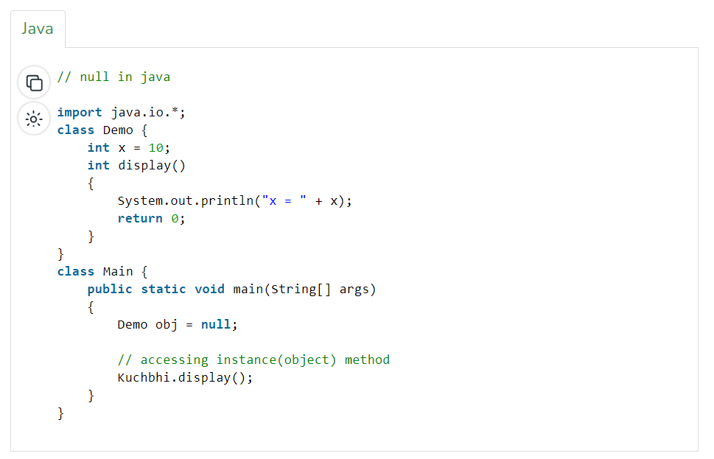

Slide 48
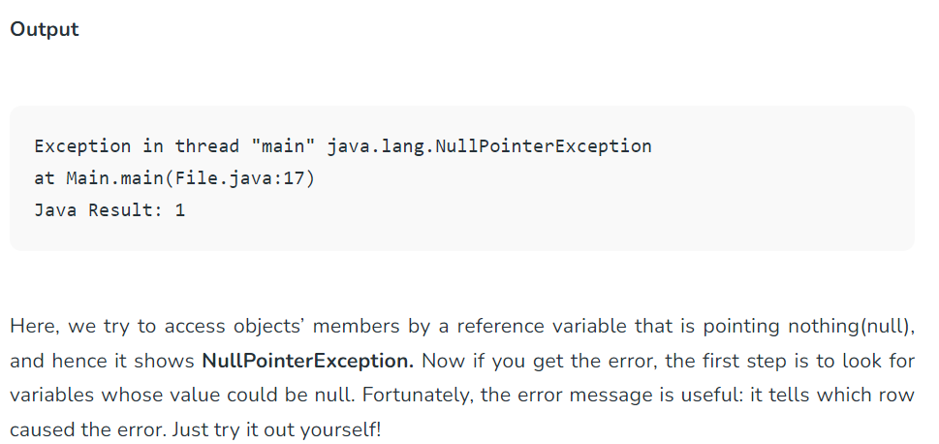

Slide 49
Read: https://java-programming.mooc.fi/part-5/4-objects-and-references

Slide 50
Java Constructors
A constructor in Java Programming is a block of code that initializes (constructs) the state and value during object creation. It is called every time an object with the help of a new opertor. Even if you haven’t specified any constructor in the code, the Java compiler calls a default constructor. The default constructor is used to assign default states and values, such as 0, null, etc., to the object. The general syntax of a constructor is:
class ClassName{
ClassName(){ //creating a constructor
}
}

Slide 51
Apart from initialization, a constructor in Java can also perform other tasks, such as calling a method, creating objects, and starting a thread. There is also a separate Constructor class in Java used to get a constructor’s internal information.
A constructor is syntactically similar to a method, but there are several differences between the two. Firstly, although it returns the current class instance, a constructor does not have any explicit return type. Secondly, it is invoked implicitly, whereas a method is not. However, similar to a method, there are a few rules for creating a constructor in Java.

Slide 52
What Are the Rules for Creating Constructors in Java?
The constructor’s and class’s name must be identical
You cannot define an explicit value to a constructor
A constructor cannot be any of these: static, synchronized, abstract, or final
One thing to note here is that you can have a public, private, or protected constructor in Java by using access modifiers that control object creation.

Slide 53
What are the different types of Java constructors?
Depending on the provided parameters, Java constructors can be of two types, which are:
No-arg constructors
Parameterized constructors

Slide 54
No-argument Constructors
As the name gives it out, no-arg constructors do not have any arguments (parameters). If you initialize multiple objects with a no-arg constructor, all the objects’ values will be the same. Syntax of a no-arg constructor in Java is:
ClassName(){}
Let’s consider the following example for a better understanding of a no-arg constructor.
No-arg constructor example
The following example creates a no-arg constructor for the Apple class, which will be invoked during object creation.

Slide 55
public class Apple{
//Creating a no-arg constructor
Apple(){
System.out.println(“This is no-arg constructor of the Apple class”);
}
//The main method
public static void main(String[] argos){
//Creating an object to invoke the constructor
Apple apple1 = new Apple();
}
}

Slide 56
Default Constructor
The default constructor that the Java compiler call is also a type of no-arg constructor as it does not have any parameters. Let’s consider the following example to understand how a default constructor works.

Slide 57
public class Car{
int carModel;
String modelName;
//using display method for printing results
void display(){
System.out.println(carModel+” “+modelName);
}
public static void main(String[] argos){
Car c1 = new Car();
Car c2 = new Car();
Car c3 = new Car();
c1.display(); //0 null
c2.display(); //0 null
c3.display(); //0 null
}
}
Since we have not created any constructor in the above example, the Java compiler calls the default one. This initializes the object with default values, and the same is displayed in the output.

Slide 58
Parameterized Constructor
Unlike no-arg constructors, parameterized constructors can accept parameters. You can make the constructor accept any number of parameters. You can use this type of constructor to assign different values to objects during creation. Here’s an example to demonstrate the functioning of a parameterized constructor in Java.
Parameterized constructor example
The following example creates a parameterized constructor with two parameters for the Car class.

Slide 59
public class Car{
int carModel;
String modelName;
//parameterized constructor
Car(int carModel, String modelName){
this,carModel = carModel;
this.modelName = modelName;
}
//using display method for printing results
void display(){
System.out.println(carModel+” “+modelName);
}
public static void main(String[] argos){
Car c1 = new Car(1001, “Mercedes Benz”);
Car c2 = new Car(1002,”Lamborghini”);
Car c3 = new Car(1003,”Maruti Suzuki”);
c1.display(); //1001 Mercedes Benz
c2.display(); //1002 Lamborghini
c3.display(); //1003 Maruti Suzuki
}
}

Slide 60
What is constructor overloading?
A constructor in Java is almost similar to a method. Hence, it can be overloaded like the latter. Constructor overloading allows you to create multiple constructors with different parameter lists. If you want to define more than one constructor and make them perform different tasks, overloading is the way to go. The Java compiler differentiates the constructors by the numbers, sequence, and data types of their parameter lists. Let’s look at an example for better understanding.

Slide 61
public class Student{
String name;
int age;
long id;
//no argument constructor
Student(){}
//one-arg constructor
Student(String name){ this.name = name;}
//Two-arg constructor
Student(String name, long id){ this.name = name; this.id = id;}
//Three arg constructor
Student(String name, int age, long id){ this.name = name; this.age= age; this.id = id;}
public static void main(String[] args){
Student s1 = new Student();
Student s2 = new Student(“Jack Black”);
Student s3 = new Student(“Jane White”,4567);
Student s4 = new Student(“Billy Jean”,24,7890);
}
}

Slide 62
How to copy values without constructor in Java?
There is no copy constructor in Java. However, you can still copy values from one object to another by using a constructor. Here’s an example to copy values of an object using a constructor.

Slide 63
public class Student{
String name;
int age;
long id;
//no argument constructor
Student(){}
//one-arg constructor
Student(String name){ this.name = name;}
//Two-arg constructor
Student(String name, long id){ this.name = name; this.id = id;}
//Three arg constructor
Student(String name, int age, long id){ this.name = name; this.age= age; this.id = id;}
//constructor for initializing another object
Student(Student s){
name = s.name;
age = s.age;
id = s.id;
}
public static void main(String[] args){
Student s1 = new Student();
Student s2 = new Student(“Jack Black”);
Student s3 = new Student(“Jane White”,4567);
Student s4 = new Student(“Billy Jean”,24,7890);
Student s5 = new Student(s4);
}
}
The above example uses constructor for copying values

Slide 64
There are also a few other ways to copy values without using a constructor in Java, which are:
Assigning values from one object to another
By using the clone() method
Let’s consider an example for copying values in Java by merely assigning values from one object into another.

Slide 65
public class Car{
int id;
String name;
Car(int id, String name){
this.id = id;
this.name = name;
}
Car(){}
//displaying results
void display(){ System.out.println(id + “ “+name);}
public static void main(String[] argos){
Car c1 = new Car(1,”Mercedes Benz”);
Car c2 = new Car();
c2.id = c1.id;
c2.name = c1.name;
c1.display();
c2.display();
}
}

Slide 66
What is method overloading?
In Java, Method Overloading allows different methods to have the same name, but different signatures where the signature can differ by the number of input parameters or type of input parameters, or a mixture of both.
Method overloading in Java is also known as Compile-time Polymorphism, Static Polymorphism, or Early binding. In Method overloading compared to the parent argument, the child argument will get the highest priority.

Slide 67
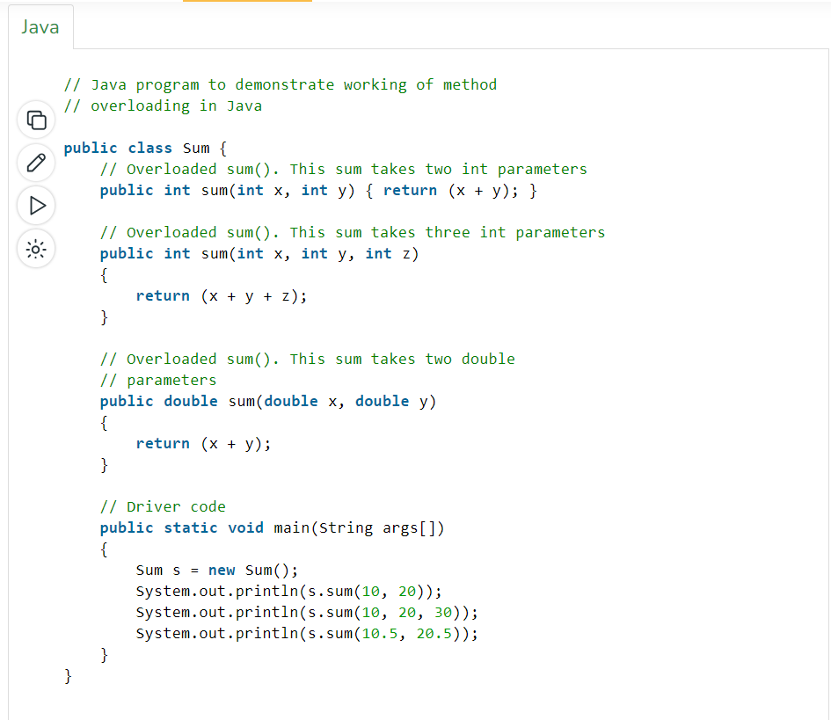


Slide 68
Different ways of method overloading in Java
Changing the Number of Parameters.
Changing Data Types of the Arguments.
Changing the Order of the Parameters of Methods

Slide 69
Changing the number of parameters
Method overloading can be achieved by changing the number of parameters while passing to different methods.

Slide 70
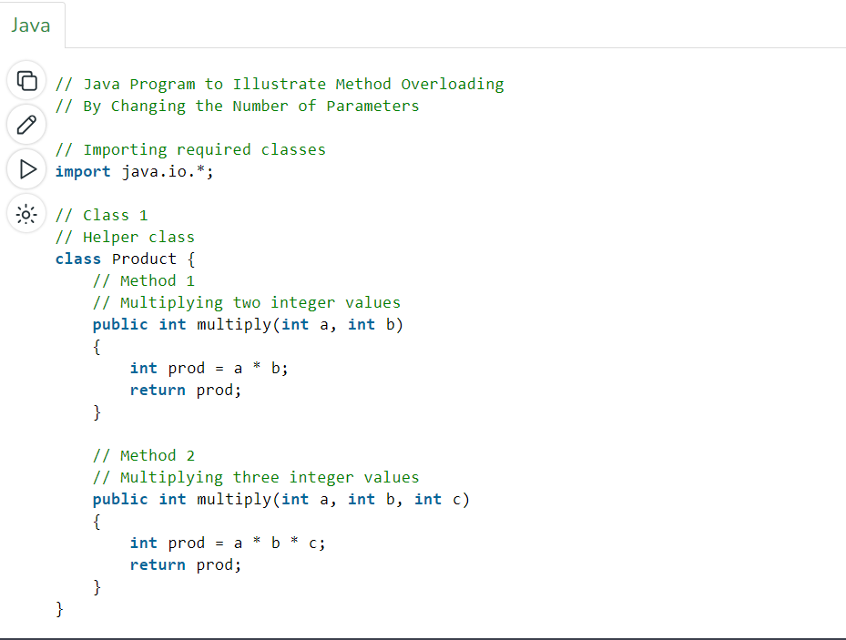
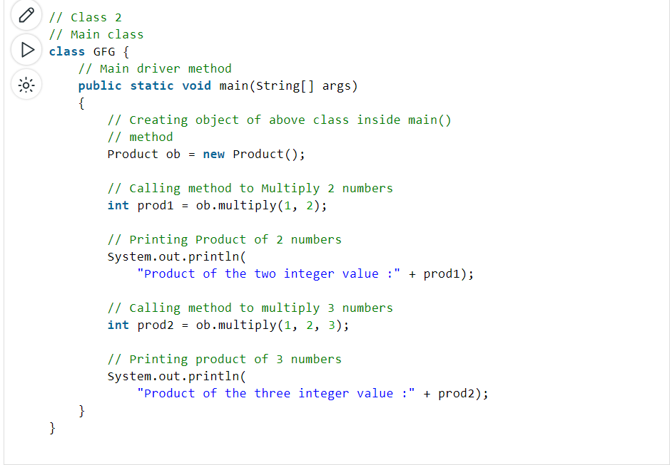

Slide 71
2. Changing Data Types of the Arguments
In many cases, methods can be considered Overloaded if they have the same name but have different parameter types, methods are considered to be overloaded.

Slide 72
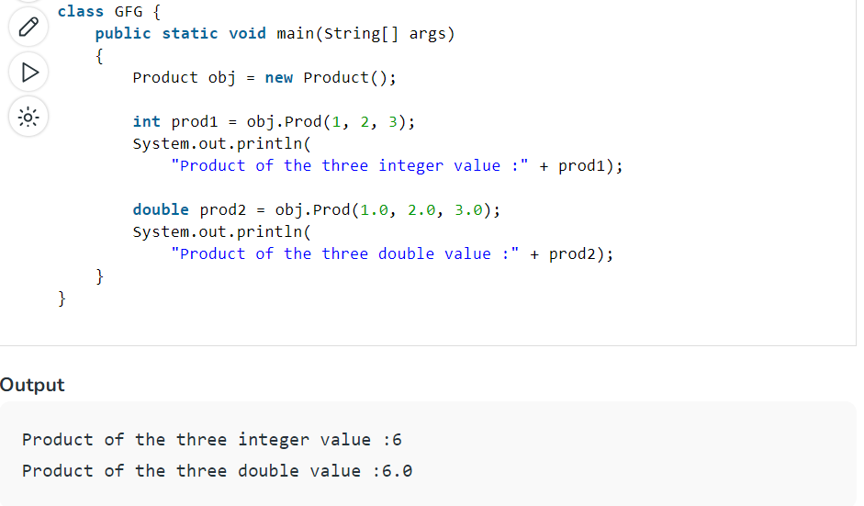
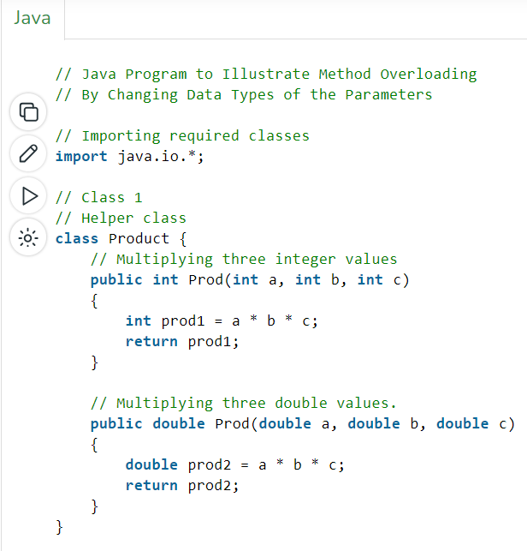

Slide 73
3. Changing the order of the parameters of methods
Method overloading can also be implemented by rearranging the parameters of two or more overloaded methods. For example, if the parameters of method 1 are (String name, int roll_no) and the other method is (int roll_no, String name) but both have the same name, then these 2 methods are considered to be overloaded with different sequences of parameters.

Slide 74
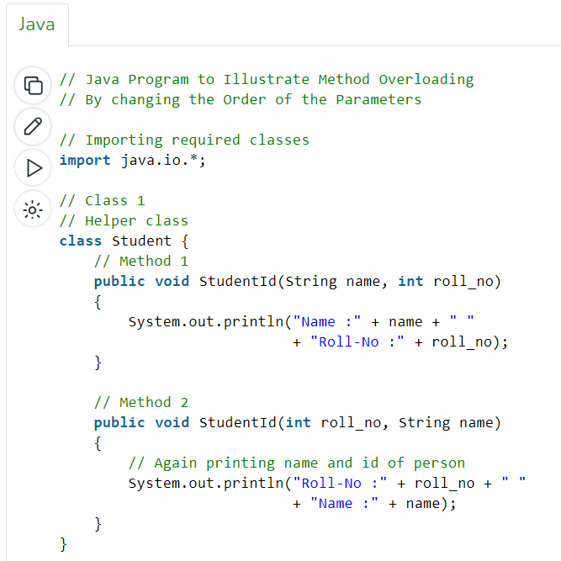
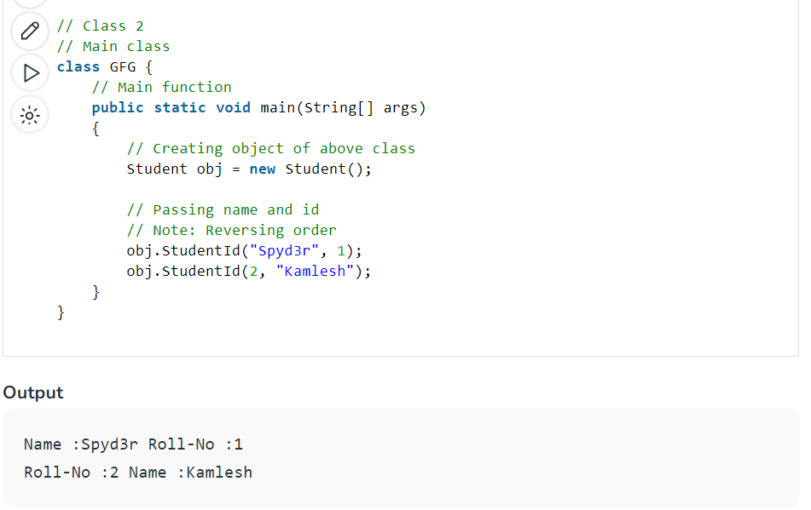

Slide 75
What if the exact prototype does not match with arguments?
Priority-wise, the compiler takes these steps:
Type Conversion but to a higher type(in terms of range) in the same family.
Type conversion to the next higher family(suppose if there is no long data type available for an int data type, then it will search for the float data type).

Slide 76
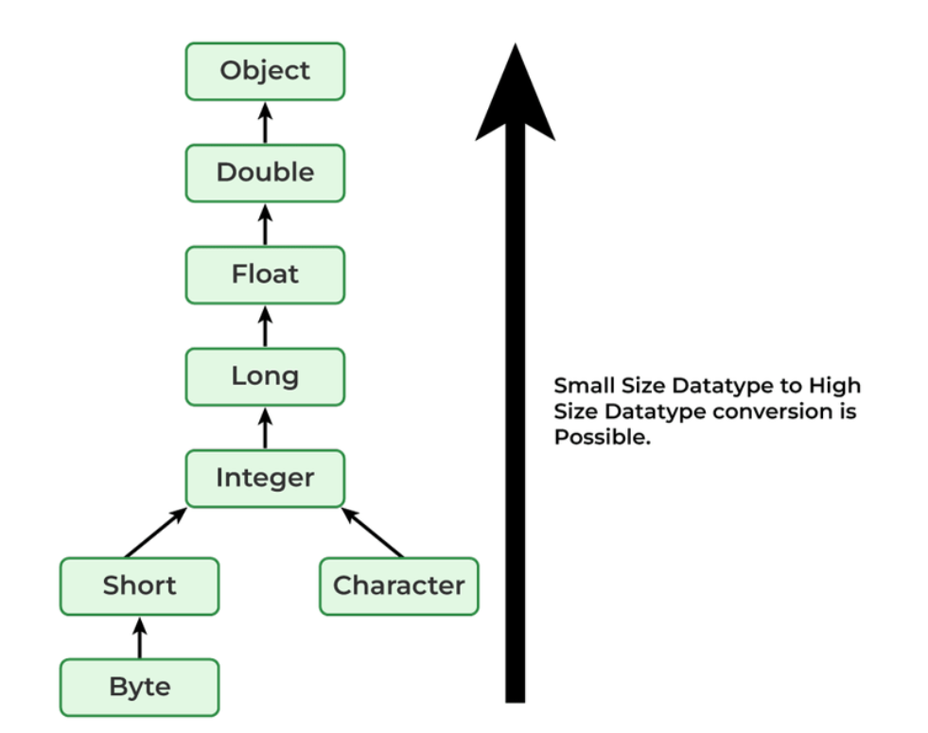

Slide 77
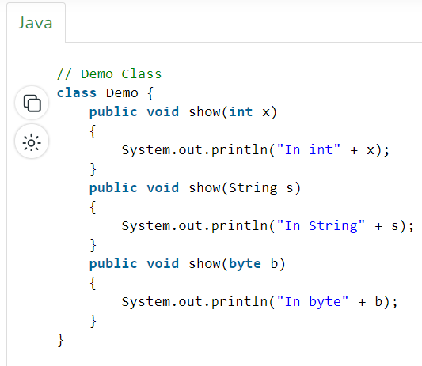
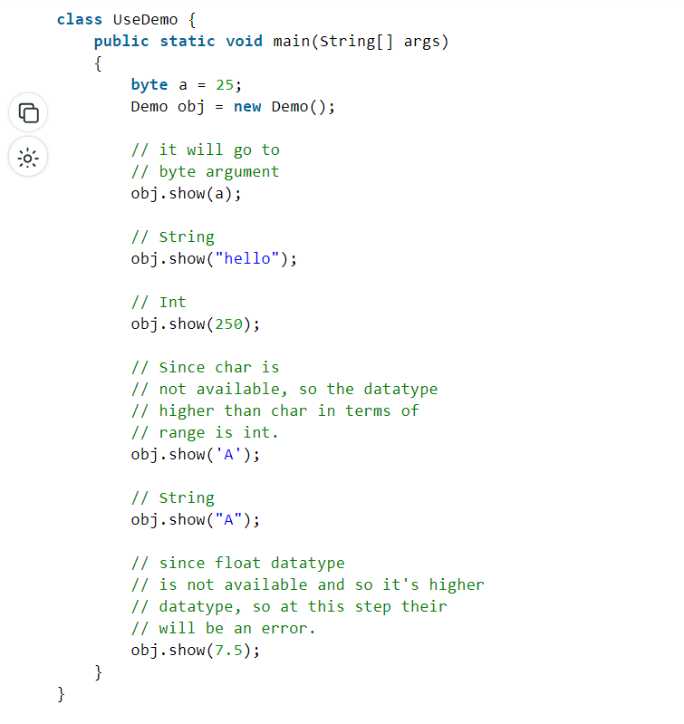

Slide 78
How to pass objects into Java methods?
In Java, you can pass objects to methods in a similar way to passing other variables. When you pass an object to a method, you are essentially passing a reference to the object. This means that any changes made to the object inside the method will affect the original object.

Slide 79
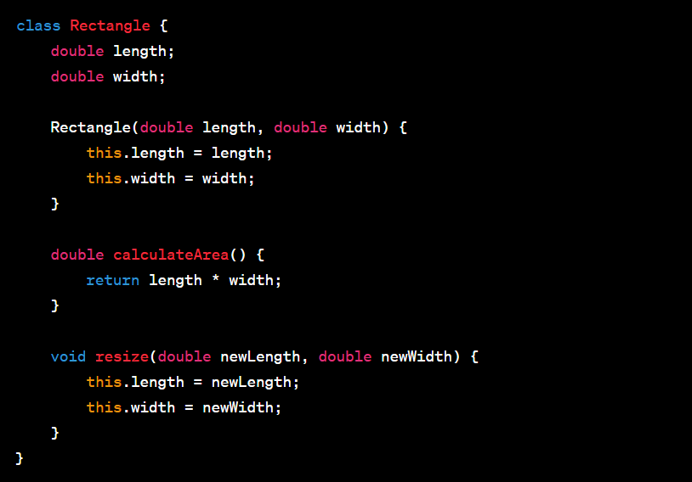

Slide 80
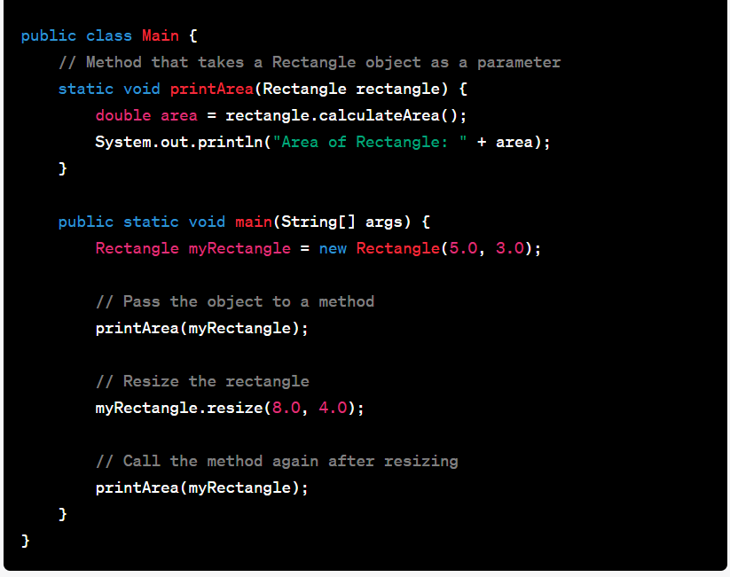

Slide 81
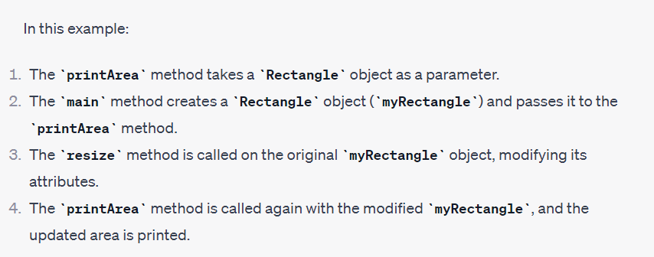

Slide 82
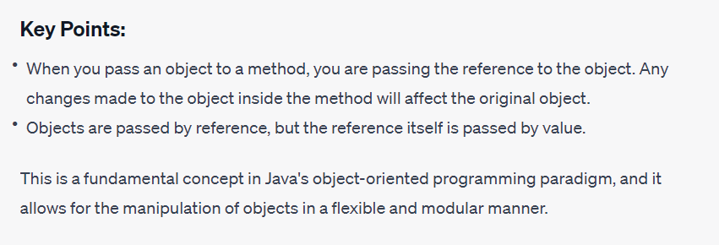

Slide 83
Significance of the new operator
The new operator in Java is used to create an instance of a class or to allocate memory for an object. It is a crucial operator that plays a key role in the process of object creation and initialization.

Slide 84
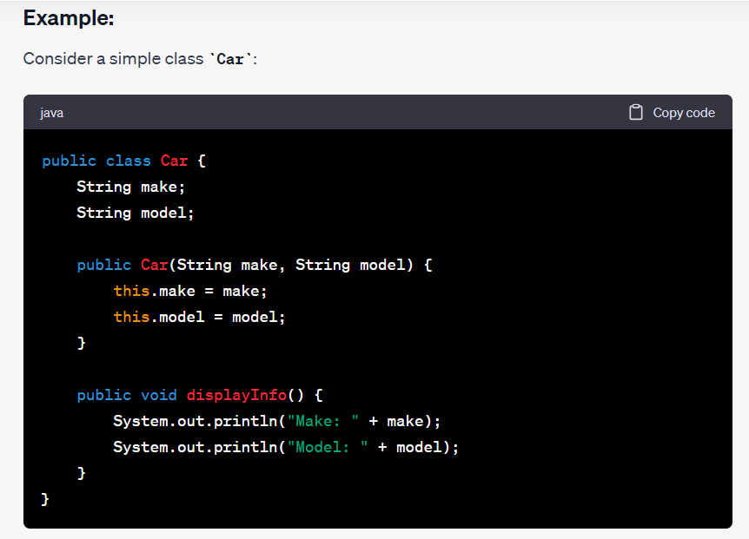

Slide 85
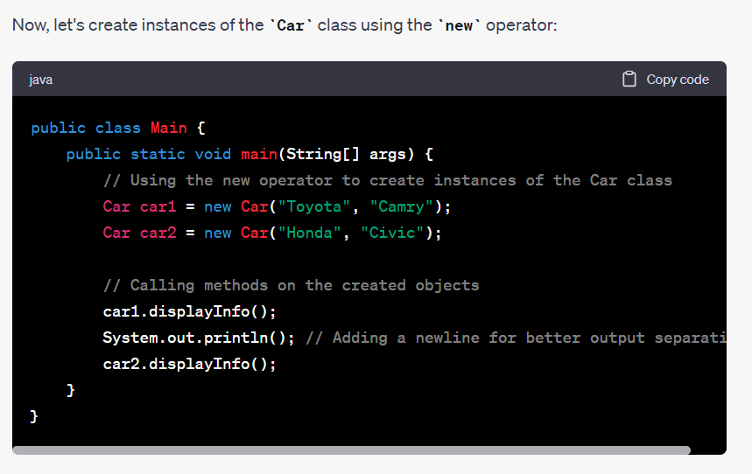

Slide 86
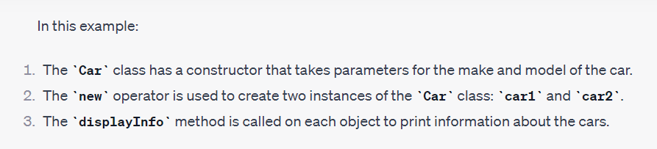

Slide 87
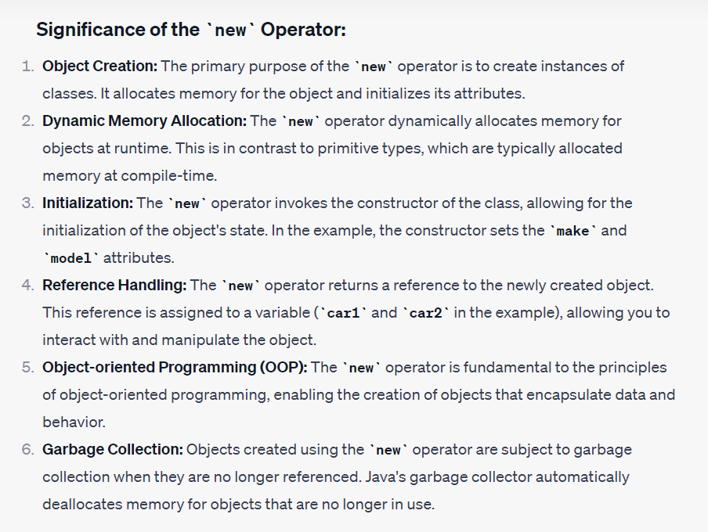

Slide 88
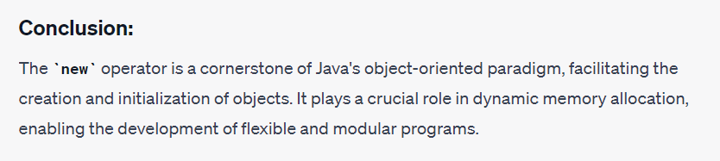

Slide 89
The significance of the this keyword
The this keyword in Java is a reference variable that is used to refer to the current object within an instance method or a constructor. It is a way to disambiguate between instance variables and parameters with the same name. The significance of the this keyword lies in its ability to differentiate between the instance variables and local variables/parameters, and it plays a crucial role in maintaining object state and ensuring proper encapsulation.

Slide 90
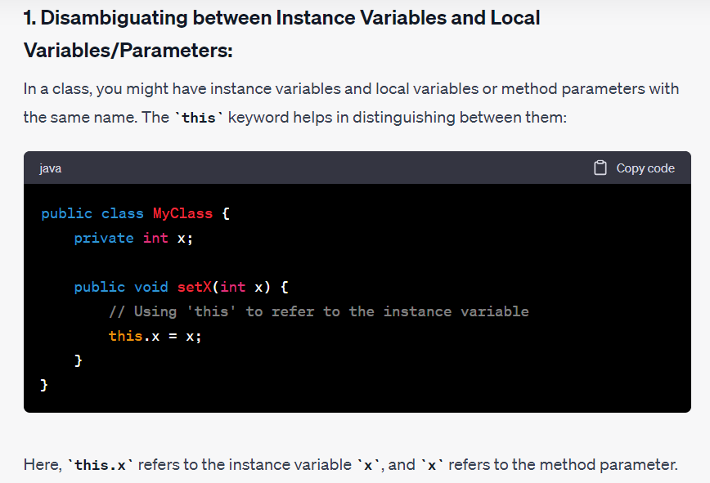

Slide 91


Slide 92


Slide 93


Slide 94


Slide 95
Significance of the static keyword
The static keyword in Java is used to create variables and methods that belong to the class rather than instances of the class. It denotes that a particular member (variable or method) is shared among all instances of the class and can be accessed using the class name rather than an instance of the class. The significance of the static keyword lies in its ability to define class-level members and perform certain operations that are not tied to a specific instance of the class.

Slide 96


Slide 97


Slide 98


Slide 99


Slide 100


Slide 101


Slide 102
Importance of finalize() method in Java
The finalize() method in Java is a method provided by the Object class, and it is called by the garbage collector just before an object is about to be reclaimed. The primary purpose of the finalize() method is to allow an object to perform cleanup operations, such as releasing resources or closing connections, before it is removed from memory. While the use of finalize() has been somewhat deprecated in modern Java in favor of other mechanisms (such as try-with-resources and AutoCloseable), it's still worth understanding its importance.

Slide 103


Slide 104


Slide 105


Slide 106


Slide 107


Slide 108


Slide 109
Package mechanism in Java
In Java, a package is a way to organize related classes and interfaces into a single namespace. It provides a mechanism for grouping classes that are part of the same functional module or category. Packages help in organizing and structuring code, avoiding naming conflicts, and providing access control.

Slide 110


Slide 111


Slide 112


Slide 113


Slide 114


Slide 115


Slide 116


Slide 117


Slide 118


Slide 119
Access modifiers

Slide 120
Access Specifiers
The various access specifiers and modifiers in Java, including final, abstract, static, synchronized, native, strictfp, transient, and volatile.

Slide 121


Slide 122


Slide 123


Slide 124


Slide 125


Slide 126


Slide 127


Slide 128


Slide 129


Slide 130
In this example, sharedVariable is declared as volatile to ensure that changes to it are visible to all threads.

Slide 131
Visibility modifier: protected
In Java, the protected access modifier is one of the four visibility modifiers used to control the access to classes, methods, and variables. The protected modifier grants access to the member (method or variable) within its own package and to subclasses, even if they are in different packages.

Slide 132
Visibility modifier: default
In Java, when no access modifier is specified, the default visibility modifier, also known as package-private, is applied. This means the member (class, method, or variable) is accessible only within its own package. This visibility is less restrictive than private but more restrictive than protected or public.

Slide 133


Slide 134


Slide 135


Slide 136


Slide 137


Slide 138
Visibility modifier: private
In Java, the private visibility modifier is one of the four access modifiers used to control the visibility of classes, methods, and variables. When a member is marked as private, it can only be accessed within the same class. This level of restriction ensures encapsulation and data hiding.

Slide 139


Slide 140


Slide 141


Slide 142


Slide 143


Slide 144


Slide 145


Slide 146


Slide 147


Slide 148


Slide 149
The final keyword
In Java, the final keyword is used to denote that a class, method, variable, or field cannot be further modified, extended, or overridden. It provides a way to enforce constraints on the structure and behavior of classes and members.

Slide 150


Slide 151


Slide 152


Slide 153


Slide 154


Slide 155


Slide 156
The abstract keyword
In Java, the abstract keyword is used to declare abstract classes and abstract methods. An abstract class is a class that cannot be instantiated on its own and is meant to be subclassed by other classes. An abstract method is a method declared without an implementation in the abstract class, and its concrete implementation must be provided by the subclass.

Slide 157


Slide 158


Slide 159


Slide 160


Slide 161


Slide 163
The static keyword
In Java, the static keyword is used to define a class-level (rather than instance-level) member. This means that the member belongs to the class itself, rather than to instances of the class. It can be applied to variables, methods, blocks, and nested classes.

Slide 164


Slide 165


Slide 166


Slide 167


Slide 168


Slide 169


Slide 170
The concept of nested class in Java
In Java, a nested class is a class that is defined within another class. There are four types of nested classes: static nested class, non-static nested class (inner class), local inner class, and anonymous inner class.

Slide 171


